Slide 1
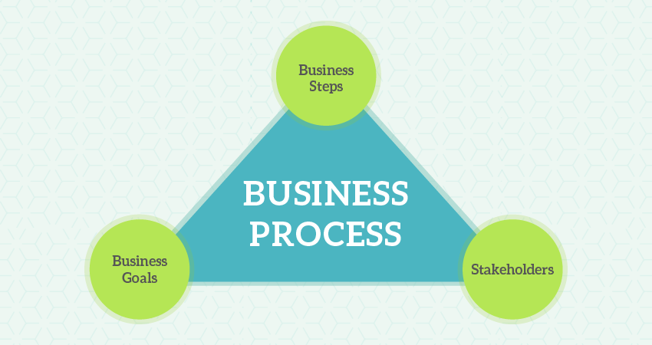
DIGITALIZATION BEST PRACTICES
Why strategy
The essence of the strategy is choosing to perform activities differently or to perform different activities than rivals so as to improve productivity, resilience, and competitiveness.
What is a Business Process?
A business process is a collection of linked tasks which find their end in the delivery of a service or product to a client. A business process has also been defined as a set of activities and tasks that, once completed, will accomplish an organizational goal.
Examples of business processes:
Recruitment process, Invoicing process, Order processing, Customer onboarding process, Accounting process, Market research process, and Product development process.
Importance of business processes:
They are important because they describe how things are done and then provides the focus for making them better and how they are done determines how successful the outcomes will be. If you focus on the right processes, in the right way, you can design your way to success.

Slide 2
Why Business Processes is important
They help organizations identify and understand the actual work required to keep the lights on and to achieve organizational objectives.
They break that work into organized, repeatable steps that workers can follow to achieve consistent outcomes.
Using repeatable steps to produce consistent outcomes helps organizations to more accurately predict the resources they need, thereby lowering the risk of over or under-provisioning valuable resources.

Slide 3
Why Business Processes is important
The consistent, repeatable nature of defined business outcomes helps lower the risk of employees introducing workarounds or individualized steps that can cause disruptions, slow work, and increase error rates.
Being able to better measure the efficiency and effectiveness of the individual steps within the process enables teams to identify and mitigate inefficiencies and bottlenecks to improve performance; this is the foundation of continuous improvement.
Teams are better able to identify where technologies -- such as robotic process automation (RPA) -- can be used to further boost effectiveness or efficiencies.

Slide 4
Business process categories and examples
Business processes can be categorized into different buckets, with the most common three as follows:
Operational processes: Also called primary processes, these processes deal with the core business and value chain and deliver value to the customer by helping to produce a product or service. Operational processes represent essential business activities that accomplish business objectives such as generating revenue. Examples of this include the following:
taking customer orders
processing product payments
managing bank accounts

Slide 5
Business process categories and examples
Supporting processes. Also known as secondary processes, these involve back-office processes within the business functions that keep the organization running. One key difference between operational and supporting processes is that supporting processes do not directly provide value to customers. Examples of supporting processes include the following:
accounting
HR management
workplace safety

Slide 6
Business process categories and examples
Management processes: These processes measure, monitor and control the activities related to business procedures and systems. Like supporting processes, management processes do not provide value directly to the customers. Some examples of management processes include the following:
internal communications
governance
strategic planning
budgeting
infrastructure or capacity management

Slide 7
Business process categories and examples
Some organizations and executives prefer to classify business processes by business function and group them under the following titles:
accounting and finance business processes
business development business processes
HR management business processes
marking and sales business processes
product delivery business process

Slide 8
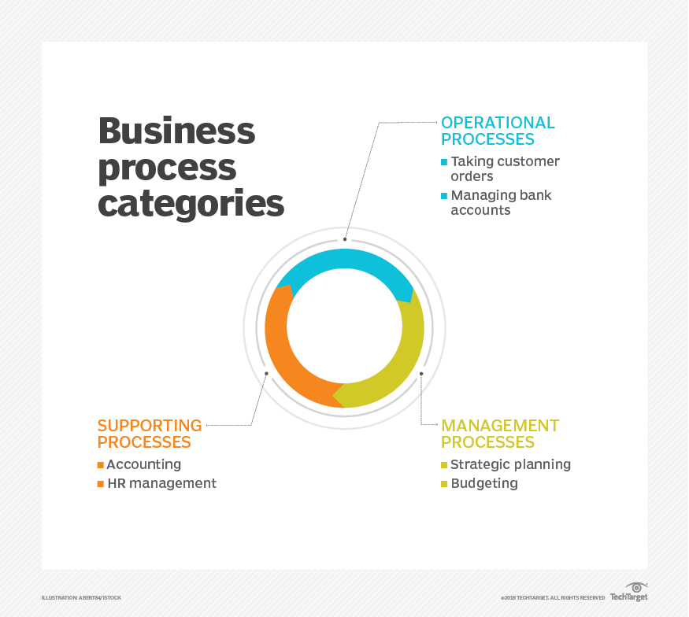
Business process categories and examples

Slide 9
DIGITALIZATION BEST PRACTICES
Having established business processes as key differentiators for sustainability and productivity of SME functional domains. The following three steps are highlighted for comprehensive digitalization of business processes:
Capture the business processes or workflow
Record the steps and interactions between the processes in your company using any range of best practice modelling tools available in the market. Establish the process hierarchy by walking through the company system from top down. This includes breaking down the company functions and activities into more and more granular processes, until the most basic steps along the chain are reached.
Analyze each process step or workflow
Identify areas of improvement and opportunities such as redundancies, inefficiencies, errors, bottlenecks, slow cycle times, areas of risk, lack of succession planning, and more from the captured processes. Example of metrics to aid in this step include sustainability in resource, scheduling, time, and cost.
Automate or digitalize
This involves automating repetitive tasks to allow your employees to contribute in more meaningful, value-added ways that improve loyalty, engagement, and job satisfaction.

Slide 10
DIGITALIZATION BEST PRACTICES
To further discuss the three steps highlighted in the previous slide, lets have a look at the Pizza Shop Analogy.
Capture the business processes or workflow
Consider a pizza shop. It's made up of a group of functions represented in a hierarchal map, from the top down. This map will consist of all the functions needed to run this fast-food chain, such as production, hiring, marketing, supply chain, etc. “LEVEL 1: CATEGORY”.
Each function is decomposed into the high-level processes that make up that function, then each of these high-level processes can be decomposed into more granular ones. The production process as an example could be divided into simpler sub-processes such as preparing the dough, the sauce, cutting and placing the toppings, and finally baking the pizza and packing it. “LEVEL 2: PROCESS GROUP”.
Even preparing the dough could be divided into even more granular steps, that includes all the ingredients needed, ideal storage conditions, etc. “LEVEL 3: PROCESS”.
This exercise is repeated until reaching the lowest level of processes, or activities, to get a finalized and detailed process map of all the company’s processes. This can go as far as “LEVEL 4: ACTIVITY & LEVEL 5: TASK”.

Slide 11
DIGITALIZATION BEST PRACTICES
To summarize:
LEVEL 1: CATEGORY
Represent the highest level of process in the enterprise. Example: Production
LEVEL 2: PROCESS GROUP
Indicates the next level of processes and represents a group of processes. Example: Preparing the dough
LEVEL 3: PROCESS
A process is the next level of decomposition after a process group. Example: Ingredients needed, ideal storage conditions, etc.
LEVEL 4: ACTIVITY
Indicates key events performed when executing a process. Example: Receive customer requests, resolve customer complaints, etc.
LEVEL 5: TASK
The next level of hierarchical decomposition after activities. Tasks are generally much more fine grained and may vary widely across industries. Examples: Create business case, reward approaches, obtain funding.

Slide 12
DIGITALIZATION BEST PRACTICES
Analyze each process step or workflow
Identify areas of improvement and opportunities such as redundancies, inefficiencies, errors, bottlenecks, slow cycle times, areas of risk, lack of succession planning, and more from the captured processes. Example of metrics to aid in this step include sustainability in resource, scheduling, time, and cost.
Start the analysis one granular process at a time to achieve a high level of effectiveness and efficiency.
Develop a RACI (Responsibility, Accountability, Consulted, Informed) chart for each process task. Basically, who is performing the task, who is approving the task was done correctly, who else has some involvement with the task, and who needs to know when the task is complete.
Some critical questions to be answered include:
Does the process add value?
Can do company do without it?
Who will the customers be for this process, both internal & external?

Slide 13
DIGITALIZATION BEST PRACTICES
Automate or digitalize
This involves automating repetitive tasks to allow your employees to contribute in more meaningful, value-added ways that improve loyalty, engagement, and job satisfaction.
No changes should be implemented until you have worked your way back up to the highest level processes as changes to one granular process may impact others.
Begin by considering the output of the process, and what it needs to be.
Define and document the requirements that must be delivered.
Identify and document your stakeholders - regulators, other functions in your organization (Human resources, IT, operations, sales, purchasing, etc.), actual end customers.
Work through each of the previously defined requirements, focusing on the minute details of the form it should be delivered in, and how to deliver on those requirements from there on together with your customers.

Slide 14
CASE STUDY
Computer center service: Business Process Reengineering
The case study paper used Business process reengineering (BPR) to improve operation of computer service processes in a computer center adopted from (Soontorn and Somjai, 2016).
Change of service processes were conducted by implementing four-phase:
Finding of current process
Analysis of current process
Redesign of Process
Applying new process and realization framework to support redesign decision making.
The new process are implemented at the computer center. The results showed that the new process was better than the current process, time of service decrease and reduce workload.

Slide 15
CASE STUDY
Process is a collection of activities across time and space from start until finish that identifies one or more kinds of input and creates an output that is of value to the customer.
The current processes is captured below:

Slide 16
CASE STUDY
The challenges found in the current processes include the following:
Request documentation process took a long time.
Current process has many steps.
Increased workload because problem is more complicate due to prolonged waiting time of service.
The redesigned processes is captured below.

Slide 17
CASE STUDY
Quantity of computer service
The waiting time for request documentation (minute/working times) between the current process and the new process
Type of service | Current Process (Working Times) | New Process (Working Times)
Software service | 119 | 93
Network service | 31 | 42
Hardware service | 22 | 31
Total | 172 | 166
Type of service | Current Process (Minutes) | New Process (Minutes)
Software service | 1234 | 30
Network service | 1254 | 30
Hardware service | 1003 | 30
Average | 1163 | 30
The quantity of computer service between the current process and the new process showed 172 working times and 166 working times respectively. The numbers of service in both scenarios were similar, as showed in the table below.
From data analysis found the process of request documentation had many unnecessary steps and took a long time for assignment task process. After implementation, it reduced waiting time for request documentation 1133 min/working times.

Slide 18
CASE STUDY
The Cycle time for service processes (day/working times) between the current process and the new process
Quantity of rework between the current process and the new process
Service types | Current Process (days) | New Process (days)
Software service | 2.92 | 1.51
Network service | 2.68 | 1.17
Hardware service | 2.10 | 1.41
Total | 2.57 | 1.36
Service types | Current Process (sample) | New Process (sample)
Software service | 14 | 2
Network service | 4 | 0
Hardware service | 0 | 0
Total | 18 | 2
The cycle time for service processes was 2.57 day/sample for current process and 1.36 day/sample for new process. The new process reduced cycle time for service processes 1.21 day/working times
The impact of time lags was that the effect of the operation did not work as planned, which had rework. The number of rework was 18 times (10.47%) in current process and 2 times in new process (1.20%).

Slide 19
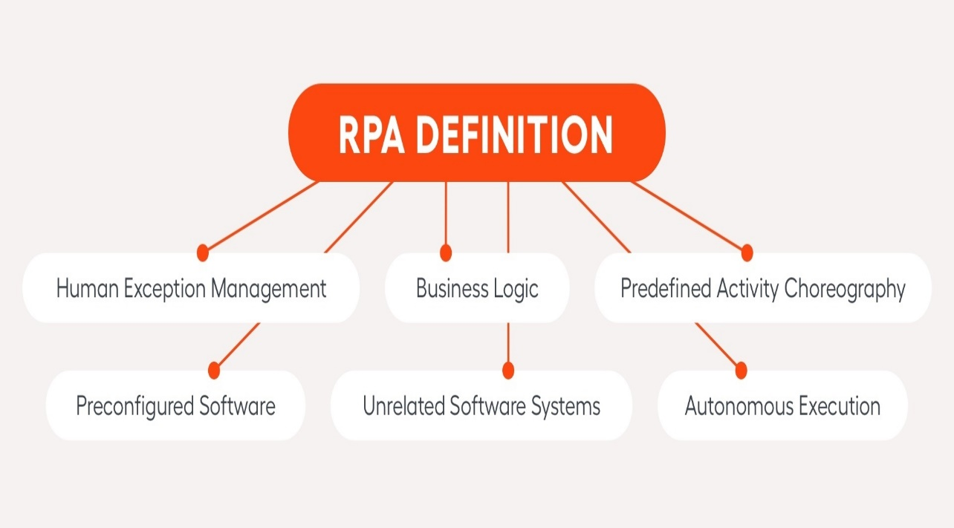
CONCLUSION
This case study used BPR cycle to improve the process and presented framework for support redesign decision making, which created new process that suitable to environment of organization.
The new process of computer service center is better than the current process by resulting in 3 items of the performance improvement. Because the new process reduced 6 unnecessary steps especially in request documentation that took a long time.
The request documentation was changed to call center system that reduced time 1133 minutes/sample.
Finally, we could optimized the task assignment due to reducing the rework. This successfully decreased cycle time and waiting time.
Robotic Process Automation (RPA) is a form of business process automation technology based on metaphorical software robots or on artificial intelligence /digital workers. It is sometimes referred to as software robotics.

Slide 20
Business process management
Having established defined business processes, organizations should then engage in business process management.
BPM is at its core the discipline of studying and improving the business processes that exist within the enterprise. It typically involves first designing and implementing the processes and then doing the following:

Slide 21
Business process management
Having established defined business processes, organizations should then engage in business process management.
BPM is at its core the discipline of studying and improving the business processes that exist within the enterprise. It typically involves first designing and implementing the processes and then doing the following:
analyzing
managing
monitoring
modeling
redefining those existing processes

Slide 22
Business process management
These activities help organizations oversee their existing processes to ensure they are operating smoothly and producing the intended outcomes.
They also identify areas for improvement and help organizations implement changes to create better processes.
BPM and the use of BPM software deliver numerous benefits by lowering the risks of the following:
errors and bottlenecks that can disrupt the flow of processes;
redundant activities within processes; and
wasted resources.

Slide 23
END

